Slide 1

James Touthang

Slide 2
What is this?
A crowdsourcing marketplace that makes individuals and business outsource their process and jobs to a distributed workforce.
In other words…
Other people around the world will do small jobs on the web for you.

Slide 3
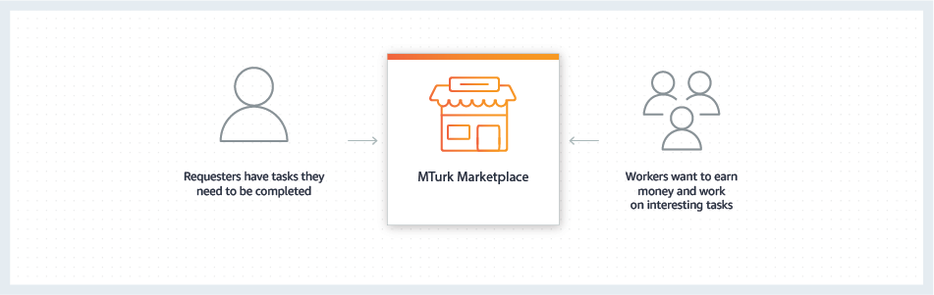
How it Works
Notes:
MTurk offers developers access to a diverse, on-demand workforce through a flexible user interface or direct integration with a simple API. Organizations can harness the power of crowdsourcing via MTurk for a range of use cases, such as microwork, human insights, and machine learning development

Slide 4



Use Cases
Machine Learning
Annotating images to help classify objects
Larger scale - focus groups
Feedback on websites, menus, food
Test ReTest
Online assessment of task to test reliability

Slide 5
Overall Basic HIT Flow
1) Worker sees HIT
4) Worker does not get Paid for the HIT
2) Accepts the HIT and performs the task(s)
Reject
3) Worker Submits the HIT
4) Worker gets paid
Approve

Slide 6
HIT (Human Intelligence Task)
The item the work that needs to be done.
Settings that can be set:
Title
Description
Keywords
Reward per assignment
Number of assignments per task (number of people)
Time allotted per assignment
Task expiration
Auto-Approval
Worker requirements
Custom criteria
Potential Explicit/Offensive content
Task Visibility
Public – all workers can see
Private – all workers can see but only those qualified may preview
Hidden – only qualified workers can see and preview
Notes:
Kind of like a craigslist post

Slide 7
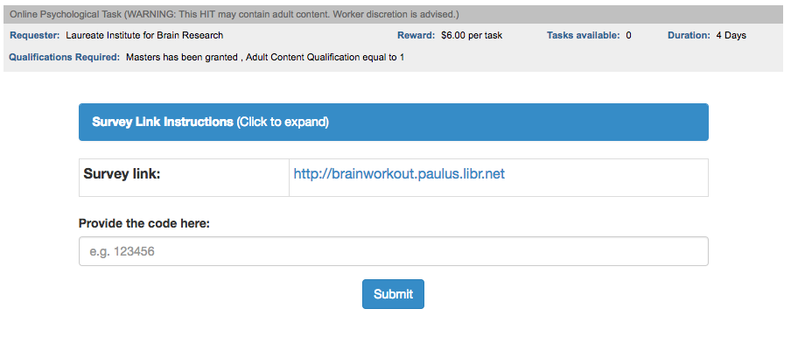

Slide 8
Chicken Task HIT
Session 2
1) Mturk Worker Clicks Proceed
Session 1
1) Mturk Worker Clicks Proceed
2) Completes Demographics Survey
24 Hour
Waiting
Period
- Use an email api – mail gun, that sends reminder email after 24 hour has passed.
2) Completes Demographics Survey
3) Complete PANAS-X Survey
4) Does Chicken Task
3) Complete PANAS-X Survey
5) Compleets Feedback survey
4) Does Chicken Task
5) Receives Code, Enters it on the HIT

Slide 10
Demographics Report Link
Brainworkout Link
Too Early Link
Completed Link

Slide 11
Pricing
Pay only what you use
Worker Reward
MTURK Fee
20% fee of reward
HITS with >10 assignments additional 20%
Masters Qualifications – 5%
>200 subject data both Dot Probe and Chicken Task
$2,120 w/ $46.15 left over.

